Slide 1
Verifying Correctness of a Chez Scheme Compiler Pass
Master’s Thesis Presentation by Ian Atol

Slide 2
Outline
Introduction
Background
Definitions
Proof
Validation Frameworks
Conclusion / Future Work

Slide 3
Introduction
Why care about compiler correctness?
Why is proving compiler correctness difficult?
Project overview
Notes:
As you can see by the title, this project is related to compiler correctness.
why should we care about compiler correctness?

Slide 4

Software is all around us - ubiquitous
Notes:
As computer scientists, we already know this, but software is already present nearly everywhere in our lives
We’re on Zoom right now, phones in our pocket, air conditioning, etc

Slide 5
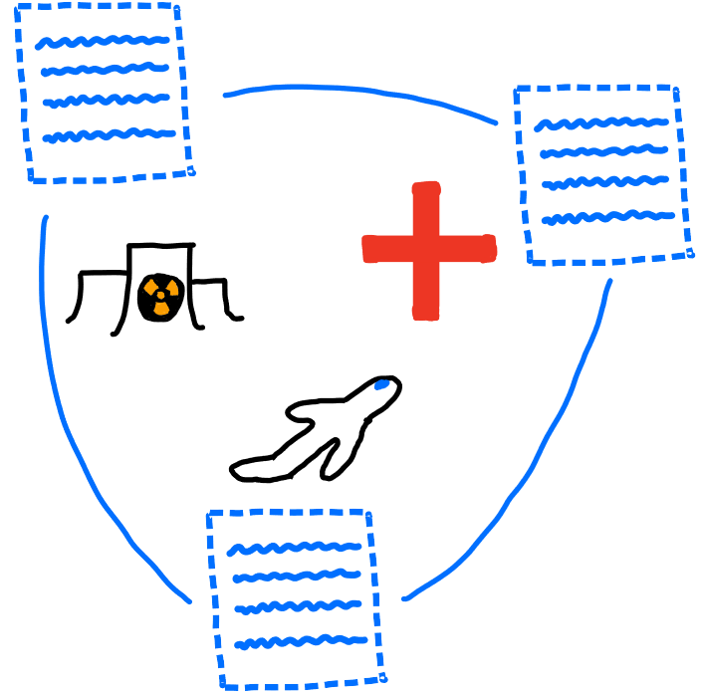
Software ubiquity means software significance
Notes:
Everywhere means everywhere - including in safety critical settings like airplanes, medical equipment, and nuclear reactors.

Slide 6

Software is imperfect
In 2011, 24% of medical device recalls were due to faulty software, and this number is increasing because of increasing complexity of devices
Notes:
We can observe this situation in many areas because complexity of hardware is increasing across the board
Needless to say, software errors in equipment thats controlling your heart or at the local nuclear power plant are very bad
So, can we fix?

Slide 7

One approach to errors – Static Analysis
Notes:
In general, static analysis is the process of examining source code.
In our case, we want to do so to devise proofs that certain kinds of errors don’t occur
Some analysis can be performed completely based on the syntax of a program – for ex, every line ending in a semi-colon.
However, for more complex proofs, we give meaning to the source code using the semantics of its language, for ex to prove a program results in a certain value

Slide 8
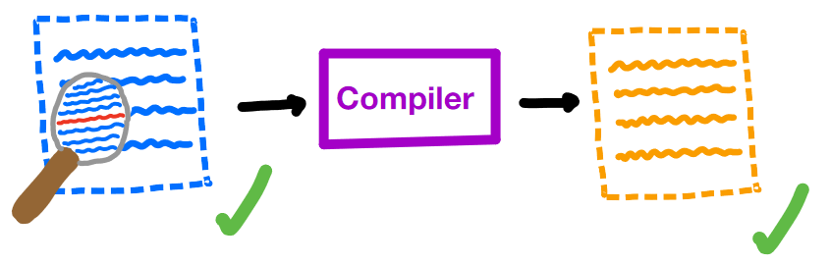
A critical assumption
Notes:
However, these proofs involving the semantics tend to make a critical assumption
We assume that our proof about a program holds for its compiled version - essentially we are trusting that our compiler didn’t make an error
For most cases, this is fine - mainstream compilers are pretty trustworthy, and most use cases aren’t critical
But if you have a pacemaker, for example, this assumption means trusting the compiler with your life

Slide 9

Minimizing assumptions
Notes:
In safety critical software, we want to minimize the assumptions we make.
Therefore, we are no longer assured that our compiled program is error free

Slide 10

Trust, but verify (our compilers)
Notes:
Compilers are really just programs themselves, so we can apply static analysis to them as well
Specifically, we want to prove that our compilers translate correctly - that they preserve the semantics of programs that they compile
If we can prove correctness of our compilers, we can successfully remove an assumption and get closer to full trust of our software

Slide 11
Why aren’t all our compilers proven correct?
Compilers are big
Multiple languages involved
Consider ALL possible programs
Notes:
gcc ~15M lines of code
Compilers typically translate a program in a high level language to a program in a low level language. So we have to create a relationship between the semantics of these languages
Finally, to prove compiler correctness, we have to consider all possible programs in a language. Even for small languages, this can involve concepts that are difficult to reason about like recursion, mutation, etc.

Slide 12
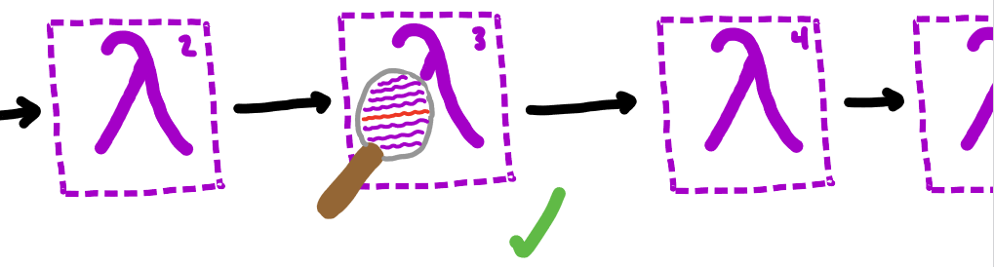
This project
Notes:
In this project, we give a proof of correctness of a single pass of the Chez Scheme compiler over a subset of Scheme
In this way, we simplify each of the problem areas:
Looking at a small part of the compiler
This pass translates from Scheme to Scheme so we can use the same semantics
We also cut out some of the language to reduce complexity

Slide 13

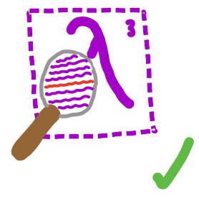

This project
Notes:
We also give two frameworks for validating our proof
The first, in Coq, was originally intended to be a complete mechanization of the proof.
While that ended up being outside of the scope of this work, we still provide an implementation of part of Scheme’s semantics and prove some basic properties about it
The second, in Racket, provides a way to show correctness of the pass (and our proof approach) for individual examples

Slide 14
Background
Compiler Correctness Proofs
Scheme

Slide 15
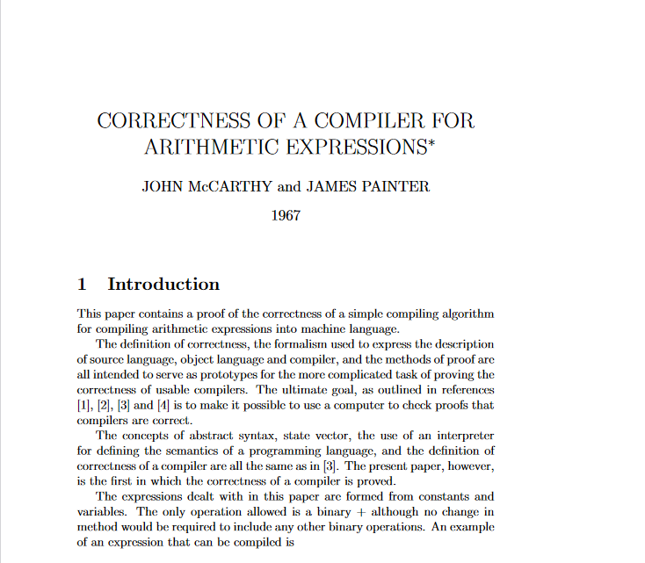
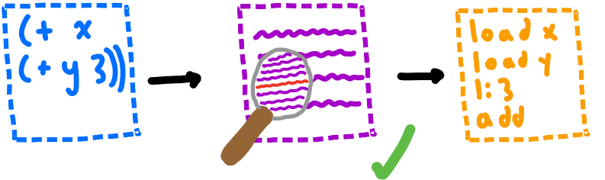
McCarthy, Painter 1967
Notes:
The first proof of compiler correctness comes from John McCarthy and James Painter
They provide a correctness proof for a simple compiler from arithmetic expressions to machine code
Their proof is intentionally simple, as they intended to create a general approach for proving correctness of larger compilers

Slide 16
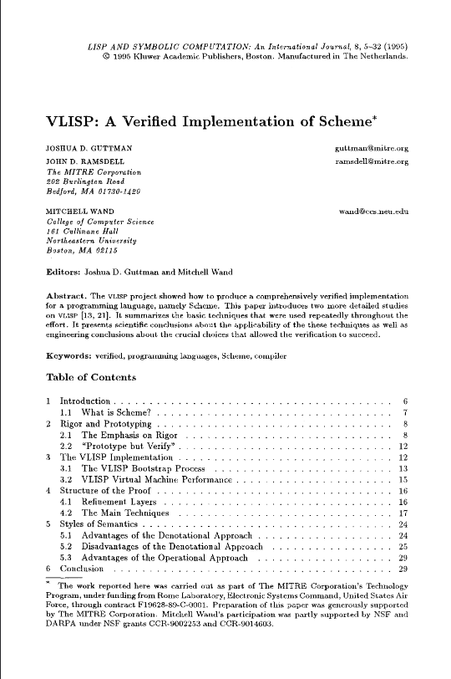

VLISP 1995
Notes:
VLISP is a proof of compiler correctness for an early version of Scheme
Also defines an operational semantics and translates between the operations and denotational semantics
Uses similar techniques to McCarthy’s proof in the operational parts

Slide 17
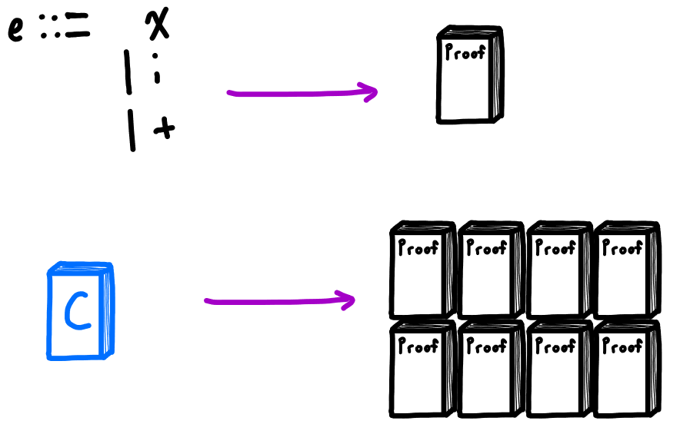
Correctness Proofs are Complex!
Notes:
McCarthy’s proof was about a tiny language of only 3 expressions, but still about 10 pages long
To reason about larger, practical languages, a proof would be very large. Still possible on paper, but checking such a proof by hand is difficult
Solution: use computers to help check

Slide 18

Solution: Mechanization
Notes:
Computers work perfectly and tirelessly – if we could get them to check our proofs, we would have a much higher degree of trust in their validity
For computers to be able to check our proofs, they need to be able to understand them first – we need to encode some system of mathematics

Slide 19
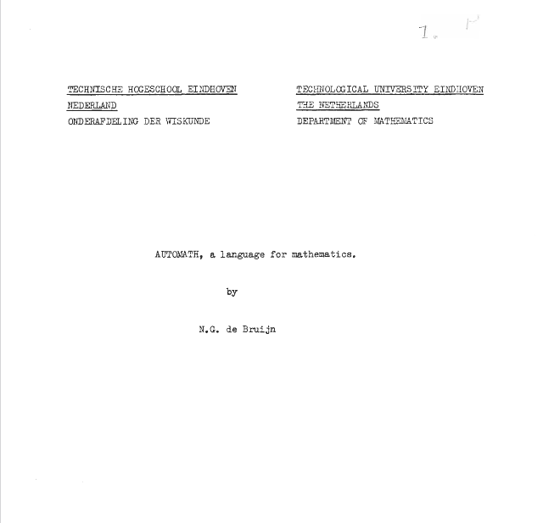
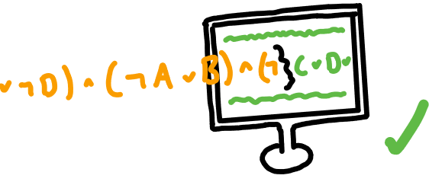
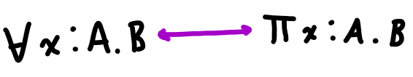
de Bruijn 1968
Notes:
In 1968, de Bruijn released Automath, a system for encoding and checking mathematical theories computationally
Automath does this by exploiting the Curry-Howard correspondence between intuitionistic logic and dependent types
So in Automath, theorems are defined as types, and proofs consist of showing that these types are inhabited by some value
Which means that proofs of theorems are just programs like any other, and their validity can be determined by type checking

Slide 20
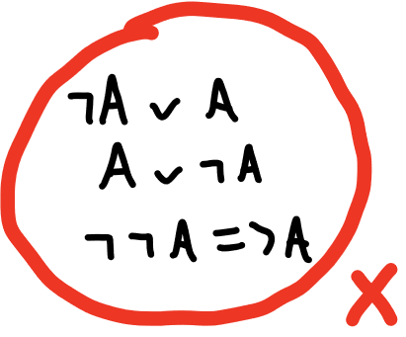

More on Intuitionistic Logic
Notes:
Automath works by exploiting a correspondence between intuitionistic logic and dependent types
But what is intuitionistic logic? Alternative to classical logic that requires direct proof – there are no indirect proofs because the law of the excluded middle is not assumed
The law of the excluded middle says that for all statements, that statement is either true or false
This means that in classical logic you can prove a statement is true by proving that it cannot be false
In intuitionistic logic, if you want to prove something is true, you must directly construct evidence that it is true using the axioms of the logic
Further, this means that to show something exists, you must actually provide it
For example, a proof that given an integer, a greater integer exists would actually build and give back the greater integer

Slide 21
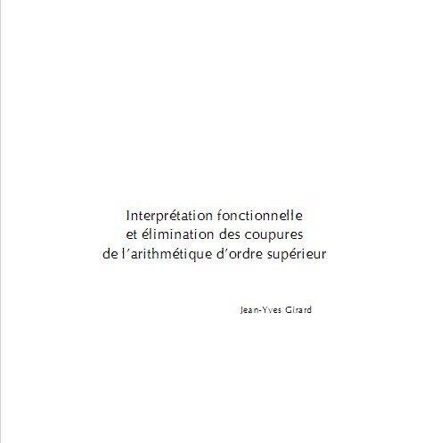
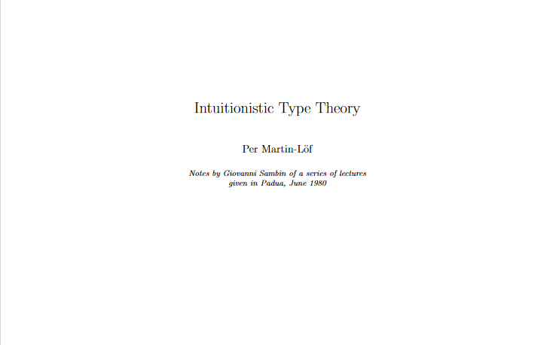
Girard 1972, Martin-Lӧf ~1980
Notes:
Martin-Lof and Girard improved on de Bruijn’s idea of exploiting the Curry Howard correspondence by developing type theories that were more expressive, therefore allowing encoding of more complex mathematical theories
Girard’s System F is similar to the type theory used by Automath, and serves as the basis for Hindley Milner type systems
Martin-Lof’s Intuitionistic Type Theory is a full fledged dependent type theory, that was intended to serve as a complete computational foundation for mathematics

Slide 22
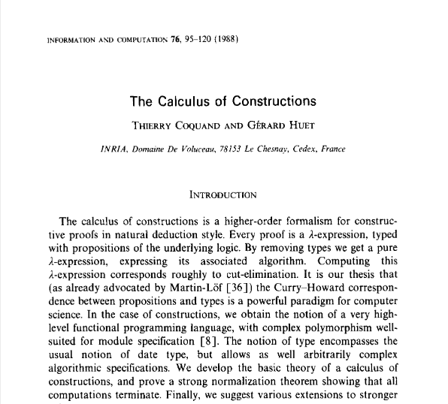
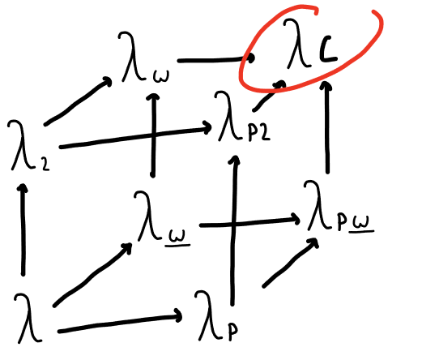
Coquand 1988
Notes:
Coquand developed the Calculus of Constructions, which combined intuitionistic type theory and system F
As you can see, it is at the top right of the lambda cube, which means that it supports parametric polymorphism, dependent types, and type constructors

Slide 23

Coq ~1980s
Notes:
Continuing his work with the calculus of constructions, Coquand began developing Coq in the late 1980s
Coq is a system based on the calculus of constructions and works similarly to Automath.
However, it provides strong tools for specification of theorems and automation of proofs, and therefore it has been used for some of the largest formal verification projects.
Two examples are the CompCert project and a mechanized proof of the four color theorem.

Slide 24
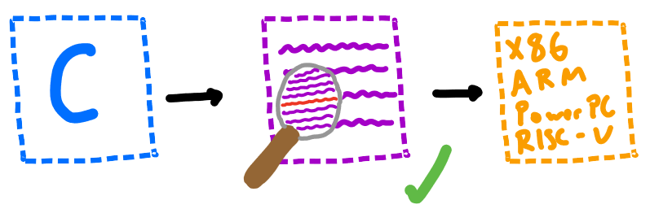
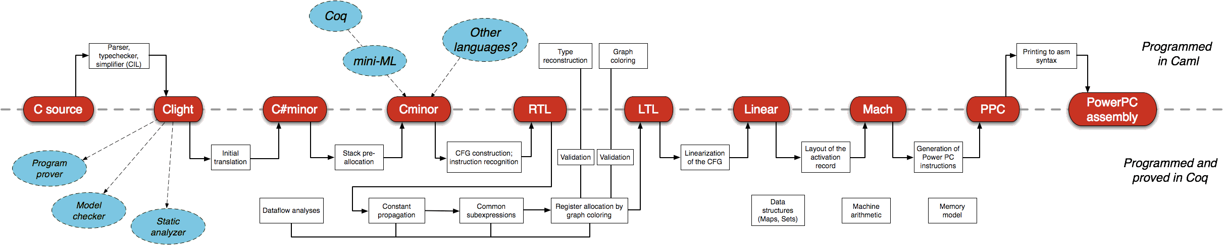
CompCert 2009
Notes:
CompCert is a verified compiler for a large subset of C
Written in Coq, it is about 100,000 lines of code and took about 6 years to complete
Formally verifies semantic preservation of its compilation
Suffice to say, it is very complex and large project that would be extremely difficult to manually verify

Slide 25



Other Compiler Verification Projects
Notes:
There are a few other verified compilers projects that are worth mentioning
CakeML is a verified compiler for a subset of ML
CertiCoq is a verified compiler for Gallina, which is the language that Coq uses to implement the Calclulus of Constructions
Finally, there have been various extensions to CompCert, such as extending it to a subset of C that supports concurrency

Slide 26
Background
Compiler Correctness
Scheme

Slide 27
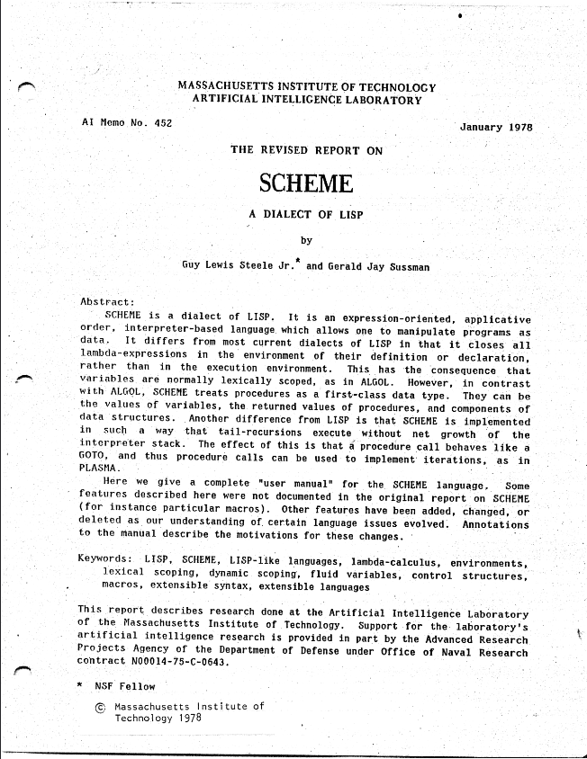

Scheme 1978
Notes:
Originally an attempt to build a LISP dialect for modeling actor-based concurrency,
While LISP supported lambda expressions, Steele and Sussman discovered they could greatly simplify LISP by following the semantics of the lambda calculus even more closely
This specifically meant using static scoping and call-by-value evaluation which more accurately follows the way the call-by-value lambda calculus works
Other important features include first class functions, homoiconity, and mutation. Though now it is also known for its macros, these were not in the original version

Slide 28
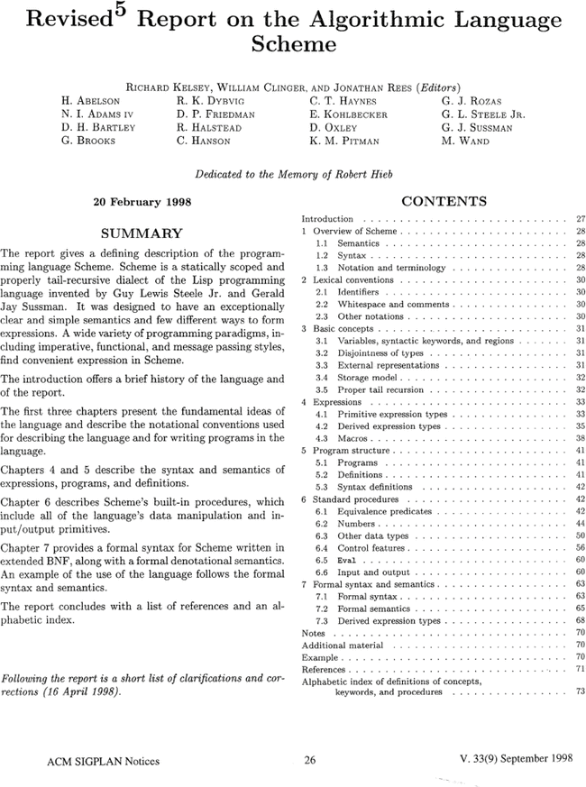
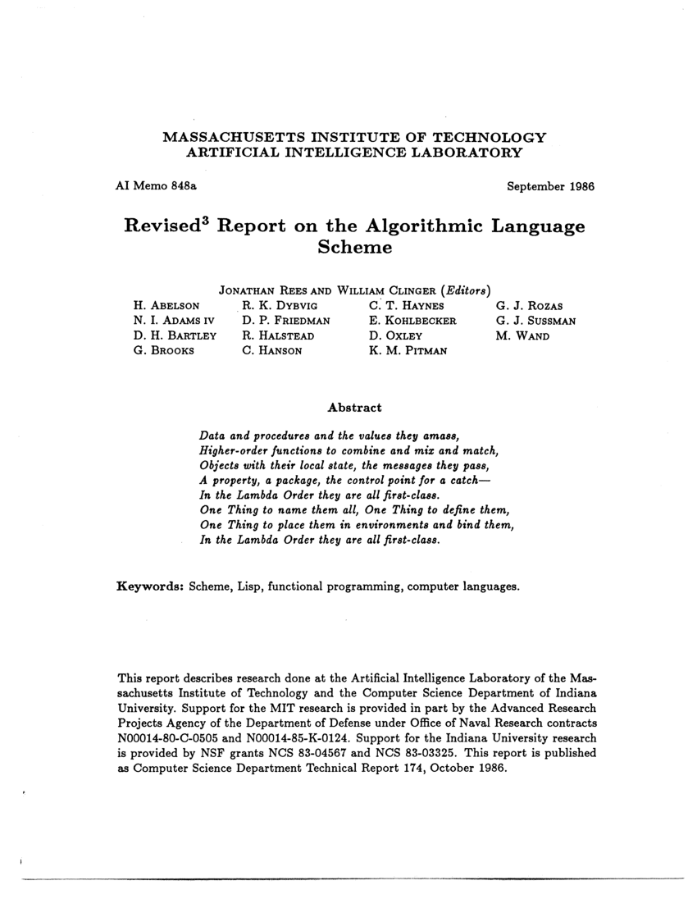
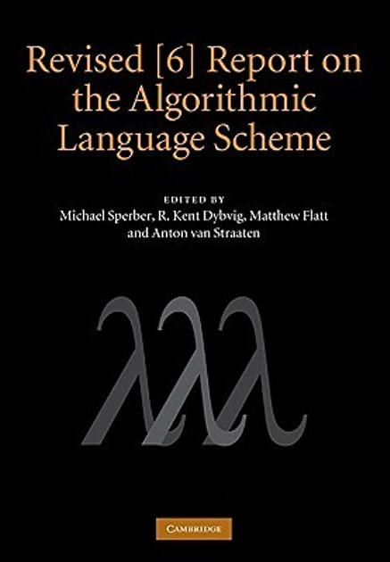
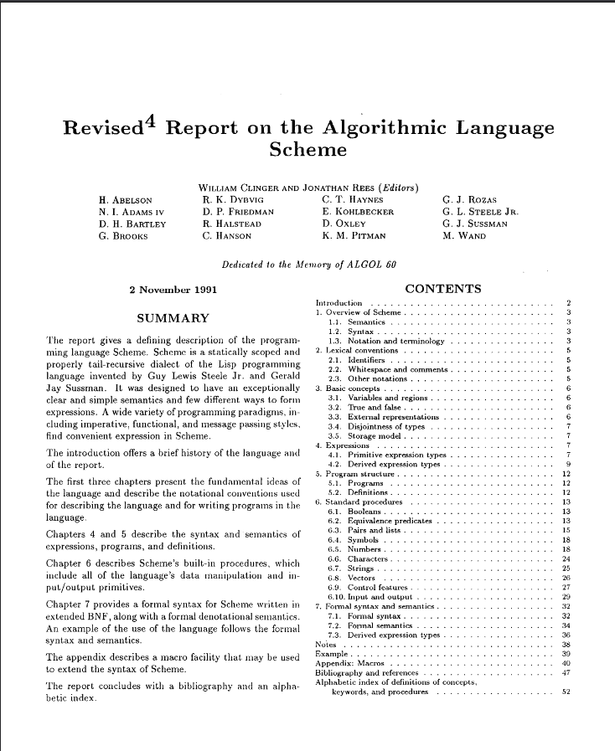
Scheme Language Standards
Notes:
Scheme has a standard in the form of the Revised n Report on the Algorithmic Language Scheme
Current version is R7RS, but we looked at R6RS because the compiler we are reasoning about is based on it
R6RS includes a formal semantics for a subset of Scheme, as well as an implementation of the semantics, which we use for one of our validation frameworks

Slide 29
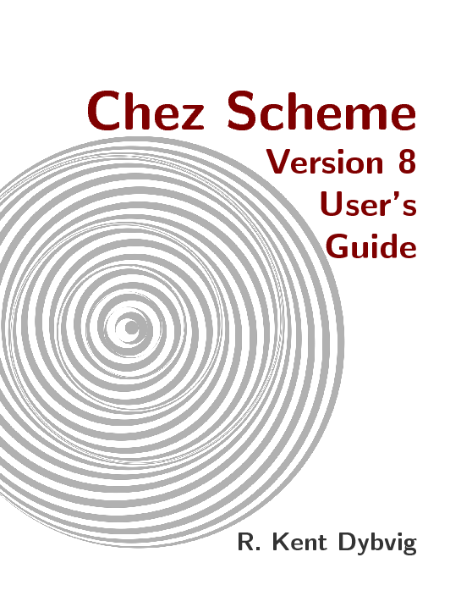

Chez Scheme
Notes:
Chez Scheme is an implementation of the R6RS standard, with an emphasis on performance
Also adds features like a C interface and concurrency
Bought by Cisco in 2011 and made open source in 2016

Slide 30
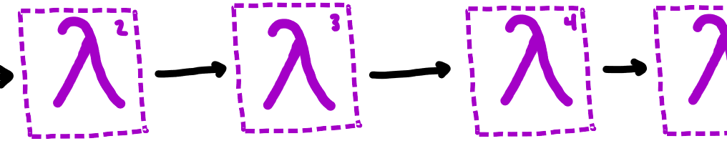
The Chez Scheme Compiler
Notes:
The compiler for Chez Scheme utilizes the Nanopass framework
Nanopass is a DSL for easily defining intermediate languages and passes between them
Focused on very small changes from pass to pass

Slide 31
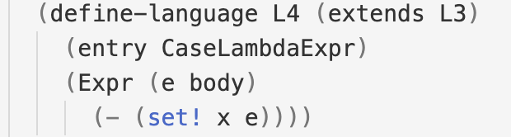
Nanopass Language Definition Example
Notes:
This is an example of a language definition in the Nanopass framework
As you can see, we define a language called L4 which extends the L3 language
The next line tells us that the pass that goes from L3 to L4 expects a case lambda expression as an argument
Finally, the last two lines tell us that L4 is L3 without set! expressions
This language corresponds to the pass that we are verifying

Slide 32
Outline
Introduction
Background
Definitions
Proof
Validation Frameworks
Conclusion / Future Work
Notes:
Questions?
Now we are going to get into the proof itself

Slide 33
Definitions
Syntax
Semantics
The convert-assignments pass
Notes:
To do so, we will define the syntax and semantics for the restricted version of Scheme that we are reasoning about
Then, we will define the compiler pass over that language

Slide 34
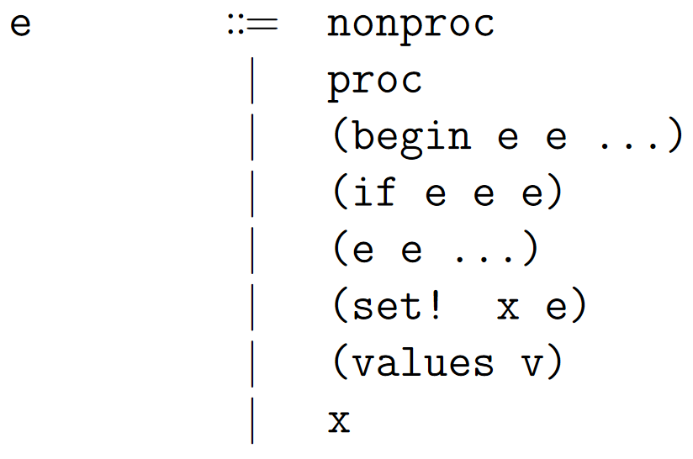
Syntax
Notes:
We begin with our expressions - expressions can be a procedure or non-procedure (more on that later)
Otherwise, they are one of the following six expressions: begin, if, application, set!, values, or a variable

Slide 35
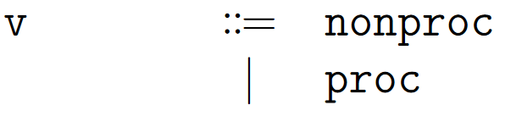
Syntax
Notes:
Expressions that aren’t one of those six are considered a value

Slide 36
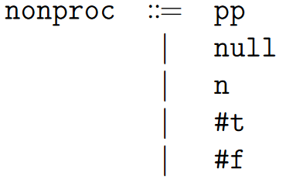
Syntax
Notes:
Next, non procedures are pair pointers, the null value, integers, and true and false

Slide 37
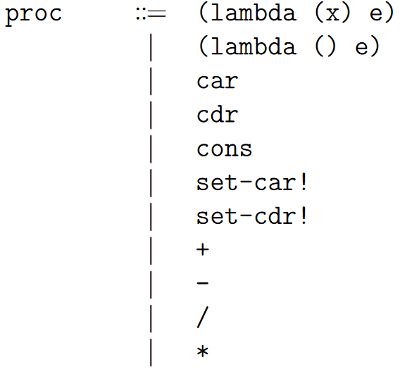
Syntax
Notes:
Procedures are, well, procedures
We have lambda expressions with one or zero arguments,
List procedures car cdr and cons
List mutation procedures set-car! And set-cdr!
and finally arithmetic procedures

Slide 38
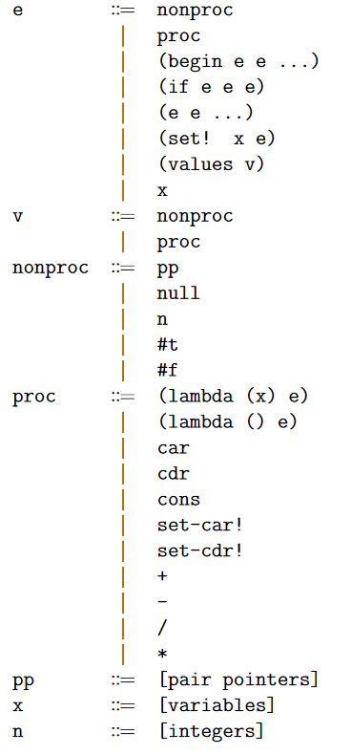
Syntax
Notes:
Thats the basic syntax of our language, but there are a couple special things I want to talk about

Slide 39
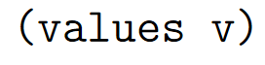
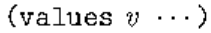
Syntax
Notes:
The first thing has to do with our values expression
In the original R6RS semantics, values is used to handle multiple value returns
We do not support that feature, but some of the semantic rules use these values expressions, and so we kept them in to be as close as possible to the semantics

Slide 40
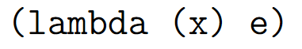
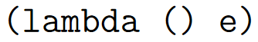
Syntax
Notes:
The next thing is that we only support lambda expressions with one or less arguments and one body expression
Again, the original semantics supports multiple argument, multi body lambdas, but we excluded that feature for simplicity, while still maintaining the structure of the relevant semantic rules, which we’ll see in a bit

Slide 41
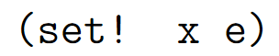
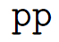
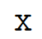
Syntax
Notes:
Finally, you may noticed that we have mutation in our language
While we don’t support top level variables, we still support mutation in local scope, and so we need a way of storing bindings to be able to update them

Slide 42
Syntax
Notes:
We do so using a store
The store is a list of our current bindings for expressions to be able to access

Slide 43
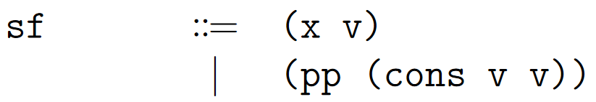
Syntax
Notes:
Store locations can either bind a variable to a value or a pair pointer to a list

Slide 44
Syntax
Notes:
Therefore, we define programs in our language as a store and an expression
That means there is only one store for each program, and we will see how expressions access and update the store when we look at our semantic rules

Slide 45
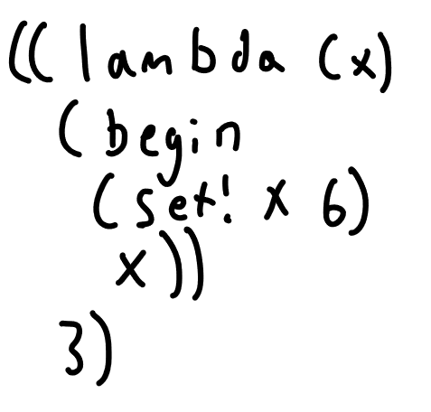
Store Example
Notes:
So lets look at a quick example of why we need a store
Imagine we have the following expression
This lambda takes an argument, sets it to 6, and then returns it

Slide 46
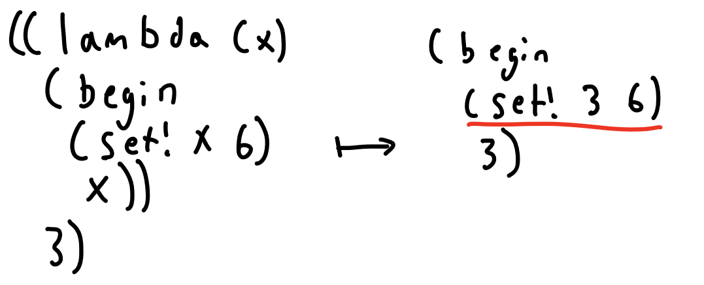
Store Example
Notes:
We haven’t seen the semantic rules yet, but if we just apply naive substitution here, we will get an invalid expression – we cant set 3 to 6

Slide 47
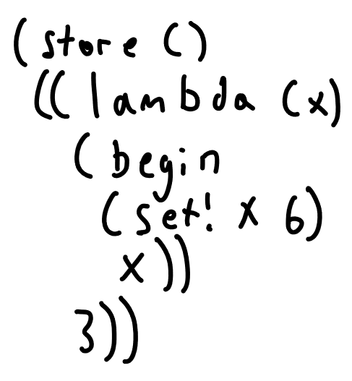
Store Example
Notes:
Now using the store, we can use a pointer for substitution to allow for mutation

Slide 48
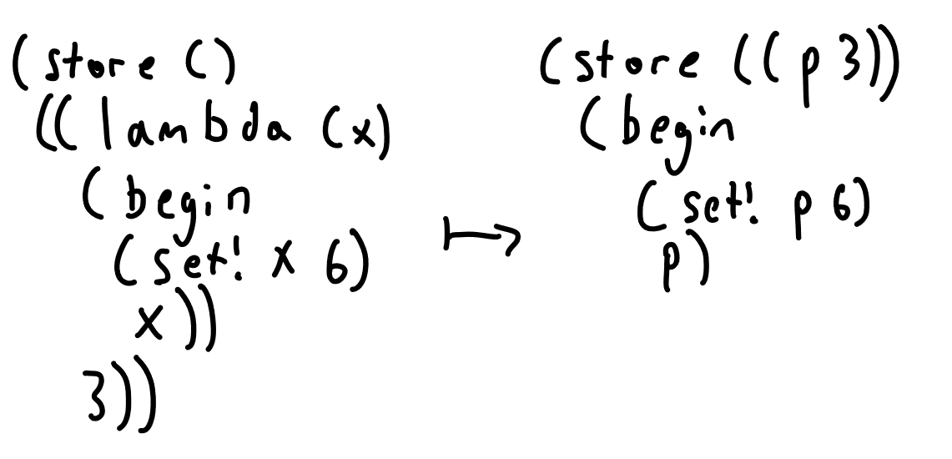
Store Example
Notes:
In this case, setting p to 6 will just update its value in the store

Slide 49
Definitions
Syntax
Semantics
The convert-assignments pass
Notes:
Now that we’ve defined the syntax for our language, we need to define a semantics

Slide 50
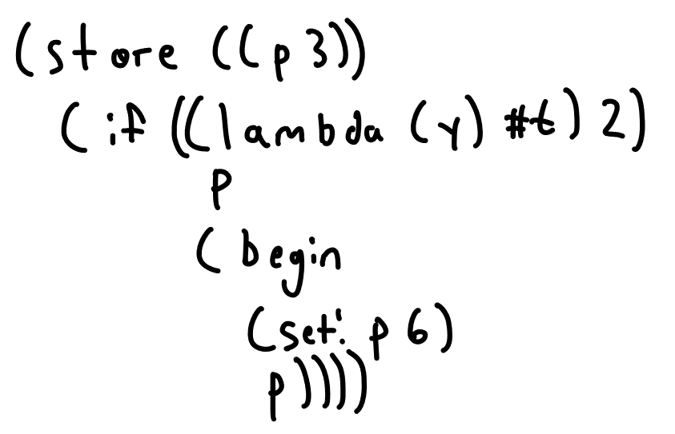
Semantics
Notes:
Before we jump into the semantics, I want to talk a little bit about evaluation order
Imagine we have the following program. We have an if expression with this lambda application as its guard, and two branches – p and a begin expression

Slide 51
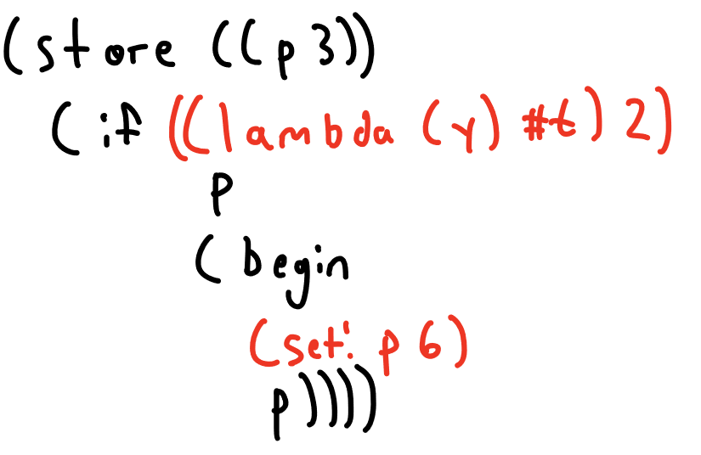
Semantics
Notes:
There are a few different reducible expressions here, but I want to focus on these two
The application will evaluate to true, so we can see that the result for this program is supposed to be 3 since we should pick the first branch
But the set! expression is also reducible. If it were to be reduced first, then our program would return 6, which we don’t want
So we need to define an order of evaluation to make sure that our programs behave as we expect them to

Slide 52
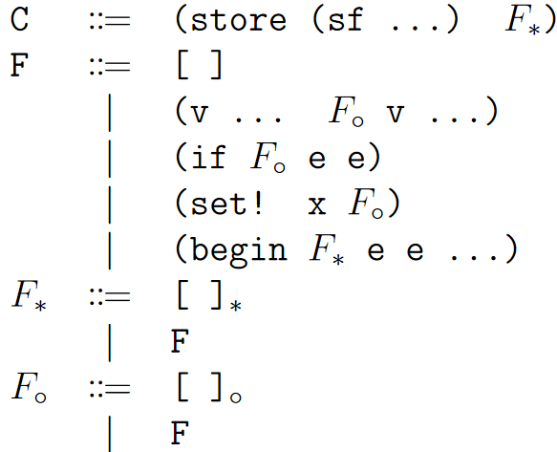
Evaluation Contexts
Notes:
The way we do this is through evaluation contexts
Evaluation contexts are congruence rules that use holes and contexts to isolate sub-expressions for reduction in a way that enforces an evaluation order.
Lets look at the previous example using this simplified version of our evaluation contexts

Slide 53
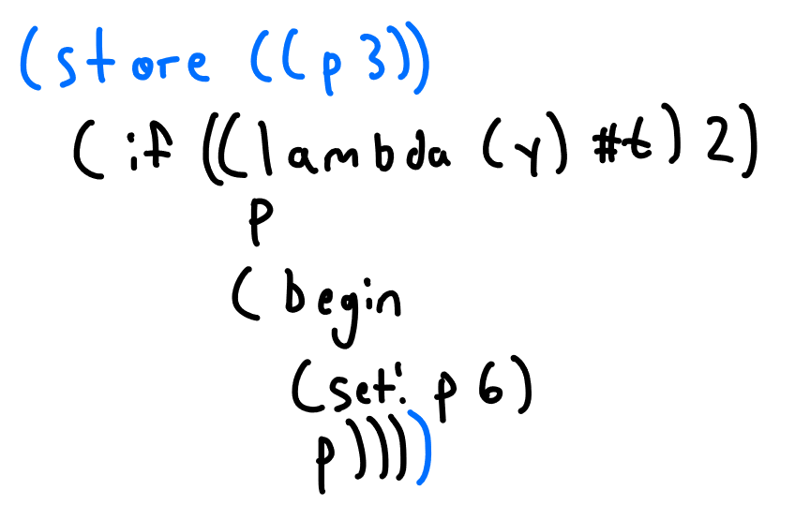
Evaluation Contexts
Notes:
The first evaluation context we apply is C, which puts the store into the context

Slide 54
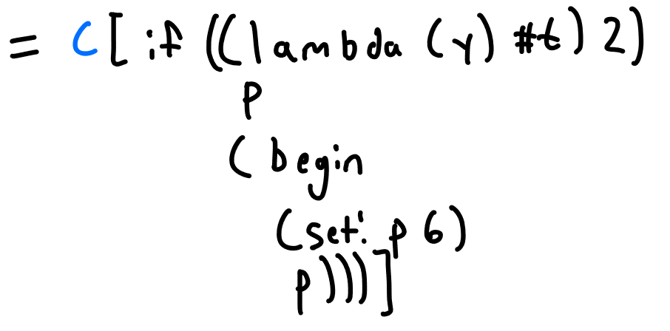
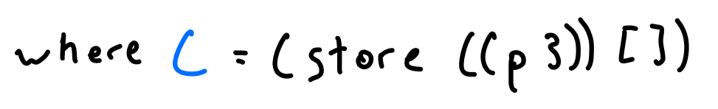
Evaluation Contexts
Notes:
We can see that our program is decomposed into a context and an expression
We can get our program back by replacing the hole in our context with the expression

Slide 55
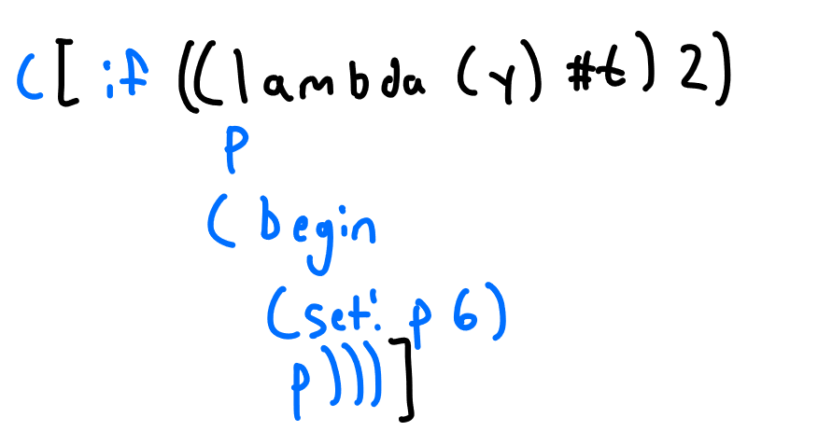
Evaluation Contexts
Notes:
Next, we can apply the if evaluation context to further isolate the application
Notice when we do this decomposing that we have to work our way from the outside in.

Slide 56

Evaluation Contexts
Notes:
Again, we can see that this would be equal to the original program if we plug our expression back into the hole in the context

Slide 57

Evaluation Contexts
Notes:
Finally, we can perform the application

Slide 58


Evaluation Contexts
Notes:
Then, since we have fully reduced our isolated expression, we can plug it back into the context

Slide 59

Evaluation Contexts

Slide 60
Evaluation Contexts
Notes:
Here are some more evaluation contexts
Notice that each one specifies which of its sub expressions are allowed to be reduced – only the ones where a hole can be placed

Slide 61
Evaluation Contexts
Notes:
Here are our full evaluation contexts
In the original R6RS semantics, F star and F circle control where multiple values can occur – F star means the hole is expecting multiple values
We do not support multiple values, but we left these in to follow the R6RS semantics more closely.
For now, just pretend F star and F circle are just F eval contexts. We will see the semantic rule that uses the star hole in a bit

Slide 62

Semantics – Control Flow
Notes:
Here is our first semantic rule, beginC
Notice that it takes place inside of an evaluation context
The beginC rule removes values expressions from the front of a begin expression
Using the begin evaluation context, we can evaluate expressions from the front of a begin statement until we get to the last one

Slide 63
Semantics – Control Flow
Notes:
However, notice that beginC removes values expressions
This is where the F star evaluation context and another rule called promote comes into play

Slide 64

Semantics – Control Flow
Notes:
The promote rule takes a value in a star hole and wraps it in a values expression

Slide 65
Semantics – Control Flow
Notes:
Notice that the begin evaluation context uses F star, which means we can choose between a normal hole or a star hole
Lets look at an example of how this would play out

Slide 66

Semantics – Control Flow
Notes:
Imagine we have the following program, a begin expression with two sub expressions

Slide 67

Semantics – Control Flow
Notes:
To start evaluating, we first put the store into the context

Slide 68

Semantics – Control Flow
Notes:
Then, we use the begin evaluation expression to isolate the first sub expression

Slide 69

Semantics – Control Flow
Notes:
From here, we can perform application

Slide 70

Semantics – Control Flow
Notes:
And plug back into our context

Slide 71
Semantics – Control Flow
Notes:
At this point, we want to remove the true value, but beginC is not applicable

Slide 72
Semantics – Control Flow
Notes:
Notice that promote only applies to values inside of star holes

Slide 73
Semantics – Control Flow
Notes:
However, the begin evaluation context allows us to choose a star hole to place the first sub expression into

Slide 74

Semantics – Control Flow
Notes:
We do so as follows

Slide 75

Semantics – Control Flow
Notes:
Now, we can apply the promote rule

Slide 76


Semantics – Control Flow
Notes:
And plug back into our context

Slide 77

Semantics – Control Flow
Notes:
Now, beginC is applicable

Slide 78

Semantics – Control Flow
Notes:
Once we have only one expression left in our begin, we can use the beginD rule to unwrap it

Slide 79

Semantics – Control Flow
Notes:
After we have applied beginD, we simply have the last sub expression left
This is how evaluation of begin expressions occurs

Slide 80

Semantics – Control Flow
Notes:
Next we have IfT and ifF which behave as expected
Notice the side condition that v1 cannot be equal to false
This implies that any non false value is considered true

Slide 81

Semantics – Lists
Notes:
Next we have the rule for cons
This rule takes an application of cons to two values, binds it to a fresh pair pointer in the store, and replaces the expression with the pointer

Slide 82

Semantics – Lists
Notes:
Car and cdr work as expected, considering cons puts a pointer in its place
Car returns the first value of the pair, and cdr the second

Slide 83

Semantics – Mutation & Reference
Notes:
First we have the var rule, which works similarly to car and cdr – takes a pointer and returns the value from the store

Slide 84
Semantics – Mutation & Reference
Notes:
Next, we have set!
This works pretty much as expected as well, replacing the value of a store location. Notice that it reduces to the null value, and only operates on store locations that already exist.

Slide 85

Semantics – Mutation & Reference
Notes:
set-car! And set-cdr! Work similarly, replacing either the first and second value of a cons store location as expected, and reducing to the null value

Slide 86

Semantics – Application
Notes:
The first application related rule is mark.
Mark is the rule responsible for enforcing left to right evaluation order of applications
The way it works is by picking the leftmost non-value expression in an application and lifting it into its own application so it can be reduced (we will see an example in a second)

Slide 87
Semantics – Application
Notes:
One thing to note is the side condition. It says that mark is only applicable when there is a non-value expression to the right of the sub-expression we lift out

Slide 88
Semantics – Application
Notes:
This side condition means that mark and the application evaluation context can never be used at the same time

Slide 89

Semantics – Application
Notes:
Now for an example of mark. We use e1 and e2 to represent non-value expressions

Slide 90
Semantics – Application
Notes:
Since the cons procedure itself is a value, mark is applicable

Slide 91

Semantics – Application
Notes:
Now, we apply mark to lift e1 into its own application
Remember that Scheme is based on the call by value lambda calculus
Therefore, we cannot directly substitute e1 since it is not a value

Slide 92
Semantics – Application
Notes:
Since lambda expressions are values, we can decompose the program using the application evaluation context
Notice that dots are like a Kleene star, so the fact that there are no values after e1 is ok

Slide 93

Semantics – Application
Notes:
We decompose the program as follows

Slide 94



Semantics – Application
Notes:
We assume that e1 reduces to some value

Slide 95

Semantics – Application
Notes:
And we can plug it back into the context

Slide 96
Semantics – Application
Notes:
Now that we have a value to apply to the lambda, we can do substitution

Slide 97

Semantics – Application

Slide 98
Semantics – Application
Notes:
Now we want to evaluate e2, but mark is no longer applicable because of the side condition

Slide 99
Semantics – Application
Notes:
Therefore, we have to use the application evaluation context to isolate and reduce e2
In general, this is how evaluation of application sub-expressions goes – we repeatedly apply mark until we reach the last non-value sub-expression, at which point we use the application evaluation context

Slide 100

Semantics – Application
Notes:
Now, we have the rule for direct substitution. We apply this only when the lambdas argument is not mutated for reasons we already saw

Slide 101
Semantics – Application
Notes:
Next we have appN!, which works by creating a fresh pointer, as we saw before. We use this when the lambas argument is mutated

Slide 102

Semantics – Application
Notes:
The final application rule, app0, removes no argument lambdas and replaces them with their body wrapped in a begin

Slide 103
Semantics – Application
Notes:
After seeing these rules, you might be wondering why they aren’t more simple
more specifically, why do we leave behind a no argument lambda, and why do we wrap bodies in begin statements?
Like the values expression, these are leftovers from multi argument lambdas
The two substituition rules in the original semantics substitute one argument at a time
Therefore, our rules are just special cases of the original rules, for lambdas with one argument
Similarly, wrapping in a begin is because multiple bodies are allowed in the original semantics

Slide 104

Semantics – Values
Notes:
These are the rules for dealing with value expressions
We already saw promote, demote does the opposite. demote is not really used by any evaluation process, but we leave it in for posterity

Slide 105

Semantics – Arithmetic
Notes:
Finally, we have our rules for arithmetic
These rules pretty much all work as expected, and aren’t super important to our proof.
We just include them to have a more complete language that you can actually do things in

Slide 106

Semantics – Arithmetic
Notes:
Finally, we have our rules for arithmetic
These rules pretty much all work as expected, and aren’t super important to our proof.
We just include them to have a more complete language that you can actually do things in

Slide 107
Definitions
Syntax
Semantics
The convert-assignments pass
Notes:
That wraps up our semantic rules
Now we will take a look at the compiler pass that we will be reasoning about, convert-assignments

Slide 108
convert-assignments
Notes:
As we hinted at before, convert-assignments translates from L3 to L4 by removing set! expressions
More specifically, it replaces them with set-car! expressions.
However, before we get into the details, there are a couple problems with trying to reason about this translation

Slide 109

convert-assignments Erasing
Notes:
The first issue is that L3 and L4 contain expressions that aren’t in the R6RS semantics
However, these expressions are essentially just R6RS expressions decorated with information for the internals of the compiler

Slide 110
convert-assignments Erasing
Notes:
Therefore, to reason about L3 and L4 using the R6RS semantics, we assume that they still abide by the same semantic rules as their “erased” version would
By making this assumption, we can prove correctness of the pass using our language

Slide 111

convert-assignments Modeling
Notes:
The second issue stems from the fact that the convert-assignments pass is written in Chez Scheme, which also contains expressions that the R6RS semantics don’t cover
Fortunately, the pass is actually quite simple, and so we model the behavior of the pass by carefully observing the pass’s code and testing many examples to learn its behavior

Slide 112

convert-assignments Intuition
Notes:
Before we define our model of convert-assignments, its best to look at an example to gain an intuition of how it behaves
The basic intuition is that convert-assignments changes all set! expressions to set-car! expressions, and changes other expressions accordingly

Slide 113
convert-assignments Intuition
Notes:
The first part of the transformation we look at is on store locations.
Since appN! is the only rule that can create new non-list store locations, we can assume that any variable in the store was once the target of a set!
Therefore, we transform them all to list store locations, since set! expressions are now set-car! expressions
Also notice that v1 is transformed, which we write as v1 hat

Slide 114
convert-assignments Intuition
Notes:
The next part is the transformation is on set!
We see that set! is transformed to set-car!, and that v2 is also recursively transformed.
Because there is a set! expression that targets its argument, lambda (y) is transformed, which will we see the full effect of shortly

Slide 115
convert-assignments Intuition
Notes:
Now we can see the effect on variables
Both variables are wrapped in a car application, since they now implicitly refer to lists
Notice that the variable from the store is transformed to a pair pointer, to match the transformation of the store location
However, we do not transform the argument variable, since it has yet to be substituted into

Slide 116
convert-assignments Intuition
Notes:
Finally, we are able to see why we introduce the additional lambda
Since our original lambda’s argument is now treated as a list, we have to ensure that the functions in its body are actually given lists
Therefore, we wrap any argument it would receive into a fresh, single element list

Slide 117

convert-assignments Definition
Notes:
Now that we have an intuition, we formally define our model of the pass
The first definition is ca prog, which just calls the appropriate functions on the store locations and expression

Slide 118

convert-assignments Definition
Notes:
As we previously observed, ca on store locations transforms non list store locations into list store locations
Store locations that already refer to a list are unchanged except for transforming their values

Slide 119

convert-assignments Definition
Notes:
convert assignments on expressions trasnforms set! to set-car! and transforms the variable depending on if its in the store or not

Slide 120

convert-assignments Definition
Notes:
On lambda expressions, it transforms those that have mutation on their argument

Slide 121

convert-assignments Definition
Notes:
If x is in the store, we transform it to car on a pair pointer
If x is not in the store, we can assume it is inside of a lambda binding it
In that case, if it is assigned to, we transform it, and otherwise we leave it alone

Slide 122

convert-assignments Definition
Notes:
other expressions are unchanged except for recursive calls on sub-expressions

Slide 123

convert-assignments Definition
Notes:
We also define convert-assignments for evaluation contexts to be able to use it on decomposed programs.
The transformations occur as expected for the equivalent expressions

Slide 124



convert-assignments Lemmas
Notes:
In our paper, we prove these lemmas, but their proofs are not very interesting, so we will just state them here

Slide 125
Proof
Overview
ca simulation
Notes:
With our language and the transformation defined, we will now begin our proof of correctness of the pass

Slide 126

Proof Overview
Notes:
We want to show that ca prog preserves the semantics of programs that it transforms i.e. the programs should take similar semantic steps
Since ca prog removes set! Expressions from programs, we can’t expect the two programs to take the same exact steps
We do expect them to take equivalent steps, though
Since ca prog introduces some additional expressions, we should expect the transformed version to take multiple steps to the originals one step

Slide 127

Multiple Steps
Notes:
we need to formally define a way for programs to take many steps
Specifically, the transitive, reflexive closure lets a program take zero or more steps

Slide 128

Equivalent Steps - Simulation
Notes:
So, overall we are trying to show that if P takes a step and then transforms, it is the same as if it transforms and then takes zero or more steps
This is the same as saying that ca prog is a simulation relation
If we can prove this, we can see that no matter how many steps P takes, that its transformed version will always take equivalent steps
Moreover, if P gets to a value, then ca prog of P will get to the transformed version of that value – basically this means that ca prog is semantic preserving

Slide 129
Proof
Overview
ca simulation

Slide 130

VSR Property Definition

Slide 131

VSR Property Proof

Slide 132

VSR Property Proof

Slide 133

VSR Property Proof

Slide 134

VSR Property Proof
Notes:
By our induction principle, we know that our subexpressions are all either values, stuck, or reducible if placed in the expression slot of a program

Slide 135

VSR Property Proof
Notes:
If there are no e2s, clearly reducible by beginD, with the unique context being just the store

Slide 136

VSR Property Proof

Slide 137
VSR Property Proof

Slide 138

VSR Property Proof
Notes:
In which case we can apply promote, and the unique context is the store, with a star hole as required by promote

Slide 139

VSR Property Proof
Notes:
If e1 is stuck, then we are stuck, since our evaluation context can only isolate the first subexpression
UNLESS

Slide 140
VSR Property Proof
Notes:
e1 is a values expression. Values expressions are stuck by our definition, but

Slide 141

VSR Property Proof
Notes:
We can apply the beginC rule in this case

Slide 142

VSR Property Proof
Notes:
With the unique context being begin

Slide 143

VSR Property Proof

Slide 144

VSR Property Proof

Slide 145

VSR Property Proof

Slide 146

VSR Property Proof

Slide 147

VSR Property Proof

Slide 148

VSR Property Proof

Slide 149

VSR Property Proof

Slide 150

VSR Property Proof
Notes:
There are many possibly applicable rules here
If our subexpressions are of the form of one of these rules, then our program is reducible by that rule
Otherwise, we are stuck, since the application evaluation context does not allow us to use the promote rule on any of these values

Slide 151

VSR Property Proof

Slide 152

VSR Property Proof

Slide 153

VSR Property Proof

Slide 154

VSR Property Proof
Notes:
Next consider if subexpressions are a mix of values, stuck, and reducible expressions

Slide 155
VSR Property Proof
Notes:
In this case, the only possible moves are either applying the mark rule or decomposing using the application evaluation context

Slide 156
VSR Property Proof
Notes:
Again, because of the side condition of mark, these two things can never happen at the same time
Since these are the only two possible moves on application expressions with mixed value and non-value subexpressions, either one of these rules is applicable or we are stuck
If mark is applicable, obviously P is reducible. Otherwise, if the application evaluation context is applicable, then P is either reducible or stuck depending on the subexpression that we isolate

Slide 157

VSR Property Proof

Slide 158

VSR Property Proof

Slide 159

VSR Property Proof

Slide 160

VSR Property Proof
Notes:
As we said before, values expressions at the program level are stuck

Slide 161

VSR Property Proof

Slide 162

VSR Property Proof
Notes:
If x is not the store, we are stuck, otherwise we can apply the var rule
Therefore, since we have considered all possibilities of e, we have shown this property of all programs

Slide 163
Proof
Overview
VSR Property
ca is a simulation relation

Slide 164
Simulation Proof

Slide 165

Simulation Proof

Slide 166


Simulation Proof
Notes:
If we consider all of the programs in our language, they must either be able to take a semantic step or not

Slide 167

Simulation Proof
Notes:
If the program cannot take a step, then we are done by contradiction

Slide 168

Simulation Proof
Notes:
If P can take a step, it must be of the form of the left hand side of one of our semantic steps
We will first consider if appN! Is applicable

Slide 169

Simulation Proof
Notes:
If so, P must be of the following form

Slide 170

Simulation Proof
Notes:
We apply the appN! Rule to get P’

Slide 171

Simulation Proof
Notes:
Next, we transform P to get P hat. Since appN! Is applicable, we know that x is assigned to inside of e, therefore we transform the enclosing lambda

Slide 172

Simulation Proof
Notes:
Simlarly, we transform p prime to get p prime hat

Slide 173

Simulation Proof
Notes:
So, we are trying to show that P hat takes zero or more steps to P prime hat
We will show that it takes 5 steps

Slide 174

Simulation Proof

Slide 175

Simulation Proof

Slide 176

Simulation Proof

Slide 177

Simulation Proof
Notes:
Now we have a lambda and a non-value expression in an application, so we have to decompose using the application eval context

Slide 178

Simulation Proof

Slide 179

Simulation Proof

Slide 180

Simulation Proof
Notes:
Then we can plug the pointer back into our original context

Slide 181

Simulation Proof

Slide 182
Simulation Proof
Notes:
As we can see, it takes 5 steps to get to p prime hat

Slide 183

Simulation Proof
Notes:
We summarize this with the following diagram
Now, lets look at some other cases

Slide 184

Simulation Proof
Notes:
For the var and set! rules, P hat takes a different step, but still only one

Slide 185

Simulation Proof
Notes:
For all other steps, ca prog does not make a significant change, and the same semantic step is taken

Slide 186
Simulation Proof
Notes:
Therefore, we have shown that ca prog is a simulation relation and semantic preserving

Slide 187
Validation Frameworks
Overview
Coq
Racket
Notes:
Questions about the proof?
In this section we will go over our frameworks for validating the proof

Slide 188


Validation Frameworks
Notes:
Now that we have given our paper proof, we are in the same position that we mentioned in the intro
Even though our proof is not exceptionally long, manually checking it still requires time and knowledge of the R6RS semantics

Slide 189

Validation Frameworks
Notes:
The original intent of this project was to fully mechanize this proof in Coq, but we ran out of time to do so

Slide 190

Validation Frameworks
Notes:
Part of the reason for that was my own inexperience with the language and with proof assistants in general, but another reason is the high level of detail required for mechanization
The nature of these proof assistants with foundations in intuitionistic logic means that every minute detail must be included to be able to prove theorems

Slide 191

Validation Frameworks
Notes:
Just as an example, we prove this property in our framework, that if a variable is fresh in an expression, substitution of that variable is the same as the identity function
In our paper proof, we don’t prove this or feel the need to, and I would be surprised if many paper proofs address this kind of lemma
This is just a single example, but it can give you an idea of the increase in scale from a paper proof to a mechanized proof
You can think of a mechanized proof as one with absolutely no handwaving allowed, even for seemingly trivial properties

Slide 192
Validation Frameworks
Notes:
What we do provide in the Coq framework is an implementation of our semantics
We also implement a model of the convert assignments pass

Slide 193
Validation Frameworks
Notes:
Since our mechanization was not completed, we wanted to have another means of validating our proof
Luckily, there is an existing implementation of the R6RS semantics
Therefore, by modeling the convert-assignment functions in Racket, we were able to test that our step theorem holds for a variety of programs
While this is far from definitive evidence of the correctness of our proof, empirical evidence of validity is always good

Slide 194
Validation Frameworks
Intro
Coq
Racket
Notes:
Next we will go over each of our frameworks in more detail

Slide 195
Coq Framework
Notes:
As I mentioned, our Coq framework is an implementation of our semantics
Therefore, we’ve already described most of the interesting details and quirks in the main part of the presentation
However, there are some details about this implementation specifically that are worth talking about

Slide 196


Capture-free Substitution
Notes:
The R6RS semantics specifies that its rules for application perform capture-free substitution
However, the means of achieving this is left up to the implementation
Inspired by Aydemir et al. on the left, we decided to use the locally nameless style for variable bindings, which provides capture free substitution and makes for easier reasoning about names

Slide 197

Locally Nameless Bindings
Notes:
In the locally nameless style, bound variables are represented by de Bruijn indices, and free variables by names, hence “locally nameless”
Since bound variables are nameless, lambda expressions do not need to specify a formal argument
The index corresponds to the level of abstraction.

Slide 198

Locally Nameless Bindings
Notes:
Here is an example of an addition function in the locally nameless style
Notice that 1 refers to the outer lambdas argument, and 0 refers to the inner one

Slide 199

Locally Nameless Bindings
Notes:
We represent variables from the store using their name

Slide 200

Locally Nameless Bindings
Notes:
The reasons for making this change are two fold
The first reason is that we no longer have to reason about alpha equivalence – each expression represents their alpha equivalence class

Slide 201

Locally Nameless Bindings
Notes:
The second reason is that capture free substitution comes basically for free, since lambdas no longer bind any names

Slide 202

Locally Closed (Well Formed)
Notes:
To support this, we have to do some management of indices on substituition, but nothing really too bad
However, a more significant problem is that this style introduces expressions that are not in the original lambda calculus
For example, this expression refers to a bound variable of a non existent outer lambda

Slide 203

Locally Closed (Well Formed)
Notes:
Luckily, we can solve this problem with an operation called open
Open recursively goes through all lambda expressions and replaces their bound variables with a fresh name
This operation is also how we convert locally nameless expressions into an actual expression in our semantics
For example, imagine we have the following badly formed expression

Slide 204

Locally Closed (Well Formed)
Notes:
We start with the body of the outermost lambda, and look for its bound variables within
So we first see this application

Slide 205

Locally Closed (Well Formed)
Notes:
and start to check inside

Slide 206

Locally Closed (Well Formed)
Notes:
Since we found another lambda, to look inside its body we have to increment our search index to correctly refer to the outer lambda
Here we find a bound variable with index 7, which does not correspond to the outer lambda

Slide 207

Locally Closed (Well Formed)
Notes:
Coming back out of the nested lambda, we have to decrement our search index
Here, we find a variable bound by the outer lambda

Slide 208

Locally Closed (Well Formed)
Notes:
Therefore, we replace it with a fresh name
Notice we also give our outer lambda an argument, to convert it into a semantic expression

Slide 209

Locally Closed (Well Formed)
Notes:
Now we have to check the body of our nested lambdas. Here we clearly cannot replace bvar 7

Slide 210

Locally Closed (Well Formed)
Notes:
Therefore, since we completed the open operation there is still a bvar in our expression, we conclude that this expression is badly formed

Slide 211
Coq Framework
Notes:
There are some other interesting parts, but in the interest of time we conclude here
If you’d like you can check out the code yourself on github

Slide 212
Validation Frameworks
Intro
Coq
Racket
Notes:
Next I’m going to talk about our framework in Racket

Slide 213

Racket Framework
Notes:
Our racket framework utilizes an existing implementation of the R6RS semantics
By defining our pass in Racket, we can test that the transformation is a simulation on individual examples

Slide 214

Racket Framework
Notes:
This framework works on individual programs
Here you can see an example of a text output from the framework, showing you the five steps corresponding to the appN! simulation
It’s a little hard to read here, but this framework is pretty easy to run so go check it out if you want

Slide 215
Racket Framework
Notes:
The actual testing framework doesn’t rely on manual inspection, instead it syntactically compares the programs
However, notice that the names are slightly different due to the R6RS fresh variable algorithm
To solve this problem in the test suite, we normalize our expressions with respect to alpha equivalence before comparison

Slide 216
Racket Framework
Notes:
Finally, one nice thing about this framework is that we have access to the entire R6RS semantics
Therefore, to test that our proof holds for other parts of the semantics, all we have to do is define the pass over those other parts, which usually just means calling it on subexpressions
This is far from a proof, but interesting to look at

Slide 217
Outline
Introduction
Background
Formalizing Scheme
Proof
Validation Frameworks
Conclusion / Future Work
Notes:
Lastly I want to go over some possible future work

Slide 218
Future Work
Notes:
The obvious future work here is to finish the mechanization of our proof
I would estimate there’s about a months worth of work left here, since we have our paper proof pretty complete

Slide 219

Future Work
Notes:
Another possibility is proving convert assignments over a bigger part of Scheme. As far as I can tell, there aren’t really any other interesting interactions, but quote and quasiquote are pretty mysterious, so who knows

Slide 220

Future Work
Notes:
Next, we can think about proving other passes. We already have a decent foundation of a formal semantics, so the next step here would be defining other passes over it.
However, other passes may operate on parts of the semantics that we didn’t include, so we may have to extend our semantics as well
There are also later passes for which we have to bring in other semantics like a semantics for x86
The ideal long term vision here would be a proof of the entire compiler

Slide 221
Thank You!
Notes:
With that, we conclude our presentation

